Slide 1


18th PhALGA Annual National Conference:
DBM PRESENTATION
DIRECTOR JOHN ARIES S. MACASPAC
DBM - Systems and Productivity Improvement Bureau
-
-
-

Slide 2

OUTLINE OF PRESENTATION
01
LEGAL BASES FOR THE DBM’s OVERSIGHT FUNCTION ON
INTERNAL AUDIT
02
OVERVIEW AND SALIENT
FEATURES OF DBM INTERNAL AUDIT MANUALS
03
PRINCIPLES AND STANDARDS OF INTERNAL AUDIT
04
DBM EFFORTS ON THE REVISION OF
THE 2016 INTERNAL AUDIT MANUAL
FOR LOCAL GOVERNMENT UNITS

Slide 3


LEGAL BASES ON THE DBM
AS AN OVERSIGHT AGENCY
ON INTERNAL AUDIT
01

Slide 4
LEGAL BASES
1
ADMINISTRATIVE CODE OF 1987
OP MEMORANDUM ORDER 277, S. 1990
2
OP ADMINISTRATIVE ORDER 119, S. 1989 (as amended) *
3
* As amended by OP AO No. 278, s. 1992 and OP AO No. 70, s. 2003
OP MEMORANDUM CIRCULAR 89, S. 2005
4

Slide 5
OVERVIEW AND SALIENT
FEATURES OF DBM INTERNAL AUDIT MANUALS
02

Slide 6
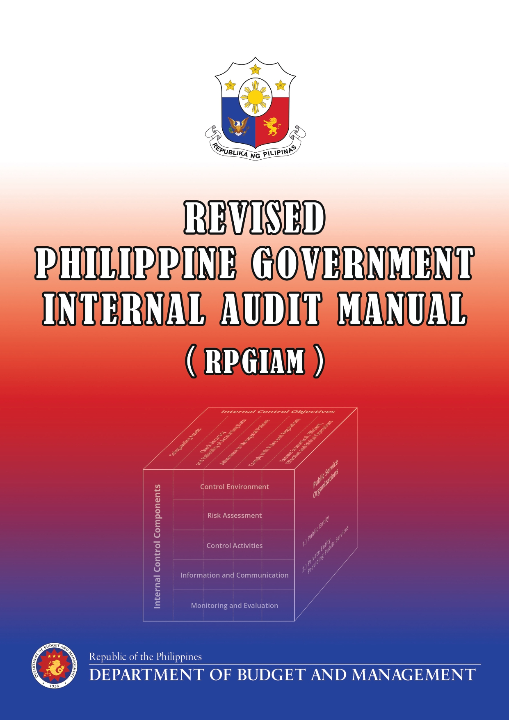
Issued under DBM Circular Letter No. 2020-8 dated 26 May 2020
Aims to assist government agencies concerned in establishing and thereafter strengthening their internal audit function to promote efficient, effective, economical, and ethical operations

Slide 7
SALIENT FEATURES OF THE RPGIAM
PART I. GUIDELINES
Outlines the basic concepts and principles of internal audit and the internal control system, as well as the policies and standards that will guide government agencies in organizing, managing, and conducting an effective internal audit
PART II: PRACTICES
Contains the approaches, tools and techniques that could be used to facilitate the conduct of internal audit activities by the internal audit unit, to assist the agency head in undertaking a separate evaluation of the IC system
APPENDICES
Include, among others, comprehensive workflow charts and diagrams of key internal audit processes to serve as guide to internal auditors

Slide 8



APPLICABILITY OF THE RPGIAM
Applicable to all departments and agencies of the Executive Branch, including GOCCs / GFIs and SUCs
Judicial and Legislative Branches and the Constitutional Offices are encouraged to utilize the RPGIAM
The LGUs shall adopt the existing IAM for LGUs, and the applicable provisions of the RPGIAM

Slide 9
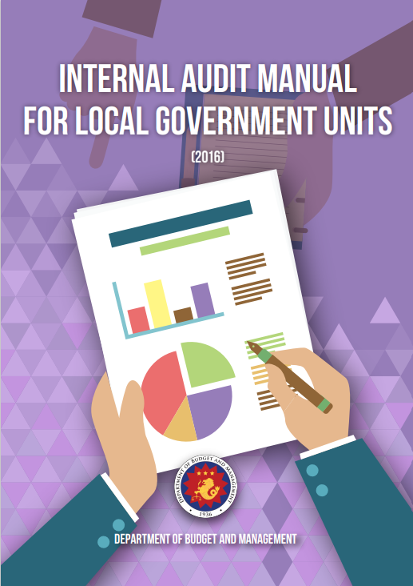
Issued under Local Budget Circular No. 110 dated 10 June 2016
Aims to guide the cities, municipalities, and provinces in establishing, maintaining, and operating an Internal Audit Service/Unit.

Slide 10
SALIENT FEATURES OF THE IAM FOR LGUs
PART I. INTERNAL CONTROL AND INTERNAL AUDIT FRAMEWORK
Contains basic information on internal control; and importance, legal bases, scope, and types of internal audit
PART II: ORGANIZING THE INTERNAL AUDIT SERVICE/UNIT
Includes the guidelines on organizational, staffing, key strategies, key attributes, and roles and responsibilities on internal audit
PART III. AUDIT PLANNING AND AUDIT PROCESS
Provides information on the conduct of strategic and annual work planning, and audit process.
PART IV. PERFORMANCE MONITORING AND EVALUATION
Includes a discussion on the importance of performance evaluation, measurement techniques, and performance monitoring
ANNEXES
Provides copy of issuances, forms, and sample internal control questionnaire and flowcharts

Slide 11

PRINCIPLES AND STANDARDS OF INTERNAL AUDIT
03

Slide 12


DEFINITION OF INTERNAL AUDIT
Internal Audit
Refers to the evaluation of management controls and operations performance, and the determination of the degree of compliance of internal controls with laws, regulations, managerial policies, accountability measures, ethical standards and contractual obligations.
Involves the appraisal of the plan of organization and all the coordinated methods and measures in order to recommend courses of action on matters relating to operations audit and management control

Slide 13
INTERNAL AUDIT FUNCTIONS
Advise the LCE or Presiding Officer of the Sanggunian on all matters relating to management control and operations audit of the Executive or Legislative Branches, respectively
Conduct management and operations audit, and determine the degree of compliance with their mandate, policies, government regulations, established objectives, systems and procedures/ processes, and contractual obligations

Slide 14
INTERNAL AUDIT FUNCTIONS
Review and appraise systems and procedures/processes, organizational structure, assets management practices, financial and management records, reports and performance standards of the agencies/units covered
Analyze and evaluate control deficiencies and assist top management to solve the problems by recommending realistic courses of action
Perform such other related duties and responsibilities as may be assigned or delegated by the LCE, or as may be required by law

Slide 15
INTERNAL AUDITING PRINCIPLES
1
Objectivity and impartiality, and avoidance of conflict of interest
Professional competence
2
3
Authority and confidentiality
4
Evidence-based approach
5
Code of conduct and ethics

Slide 16
NON-INTERNAL AUDIT FUNCTIONS
Conduct of internal quality audit as part of the ongoing implementation of the QMS
Participation in procurement procedures, including membership in the Bids and Awards Committee, its secretariat or technical working group
Preparation or review of draft policies, guidelines, standards or operating procedures of other offices
Review and certification of financial reports before approval by the agency head

Slide 17
NON-INTERNAL AUDIT FUNCTIONS
Pre-audit of vouchers and counter-signature of checks
Inspection of deliveries and conduct of physical inventories
Preparation of treasury and bank reconciliation statements
Development and installation of systems and procedures
Maintenance of property records
Consolidation and submission of reports containing agency action plans to provide the status of implementation of external audit findings and recommendations
Membership in regular management committees and special designations not in line with internal audit functions
All other activities related to operations and non-internal audit functions.

Slide 18
CLARIFICATION ON THE ROLE OF THE ACCOUNTANT IN RELATION TO INTERNAL AUDIT
Section 474(b)(1) of the Local Government Code of 1991 (RA No. 7160), provides that the accountant shall take charge of both the accounting and internal audit services of the LGU concerned, and shall maintain and install an internal audit system in the LGU.
However, given the post-audit nature of internal audit, this is separate, distinct, and detached from the regular functions of other units within the LGU. Internal audit is separate from, and not under the purview of the Office of the Accountant.

Slide 19
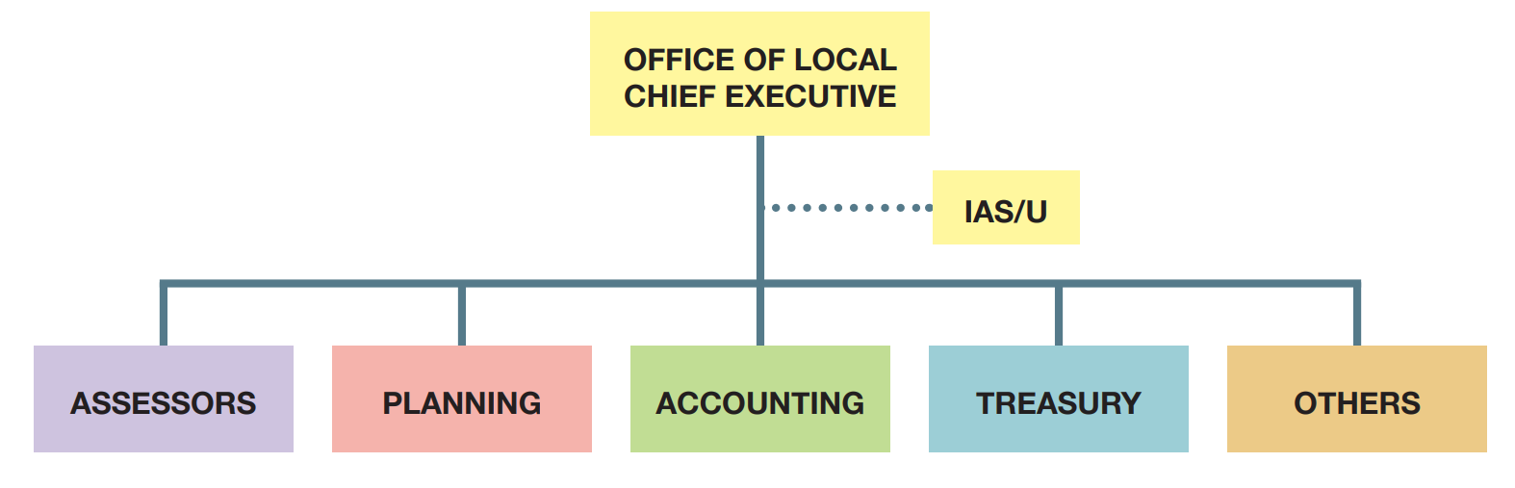
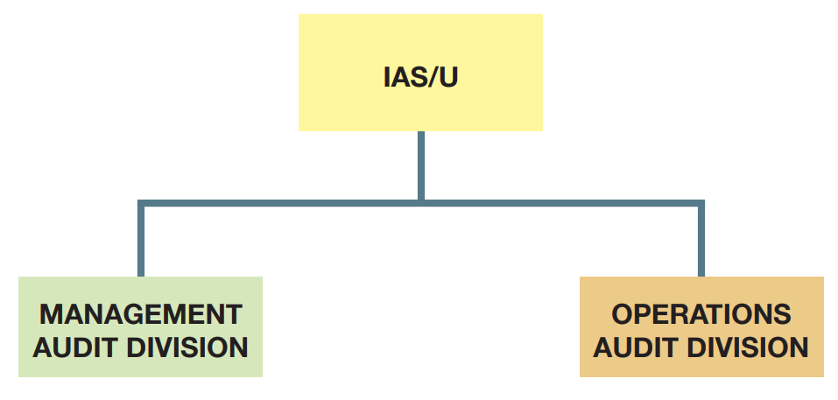
ORGANIZATIONAL PLACEMENT OF THE INTERNAL AUDIT UNIT IN THE LGU

Slide 20
GUIDELINES ON THE CONDUCT OF INTERNAL AUDIT IN LGUs
The internal audit unit shall focus on the performance of their functions consistent with the Administrative Code of 1987, as amended, as reiterated in the NGICS, RPGIAM, IAM for LGUs, other DBM issuances.
The internal audit unit should not perform non-internal audit functions, especially those that are in conflict with its post-audit functions.
The IAM for LGUs and RPGIAM shall govern the internal audit work in LGUs.
All LGUs shall be guided by the delineation of the roles and responsibilities on internal control and internal audit.
The conduct of audit shall adhere to the internal audit principles indicated in the IAM for LGUs, and the RPGIAM, as applicable.

Slide 21
DBM EFFORTS ON THE REVISION OF
THE 2016 INTERNAL AUDIT MANUAL
FOR LGUs
04

Slide 22



Salient Features of the Revised IAM for LGUs
Delineation of roles and responsibilities of various key players in the LGU
Improvement in the communication between the internal audit unit and its principal
Concrete examples of the various types of audits

Slide 23





Salient Features of the Revised IAM for LGUs
More comprehensive and detailed internal audit processes, and general templates
Actual examples of non-audit functions
Distinction between internal audit and internal quality audit

Slide 24
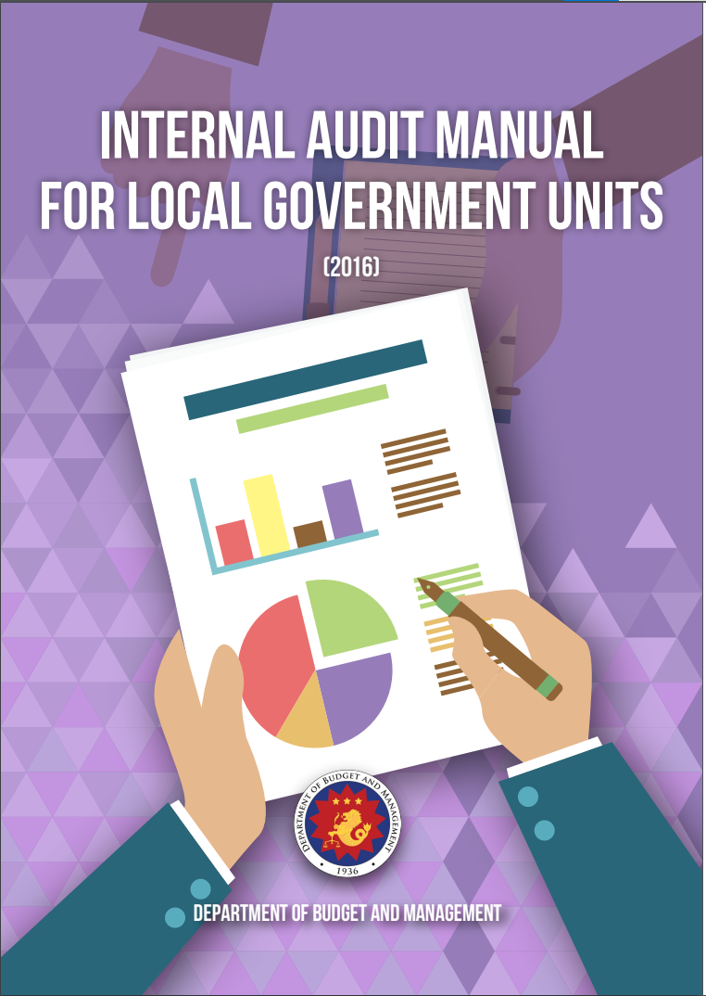
REVISED INTERNAL AUDIT MANUAL FOR
LOCAL GOVERNMENT UNITS
Executive Briefing/Orientation will be conducted this year.
The Training of IAS/U will be conducted by the Recognized Resource Persons of the Revised Philippine Government Internal Audit Manual (RPGIAM).

Slide 25

OTHER DBM UPDATES
01
Updated Budget Operations Manual for LGUs
Draft Local Budget Memorandum re: FY 2024 National Tax Allotment of LGUs
02
03
Updates on Full Devolution

Slide 26
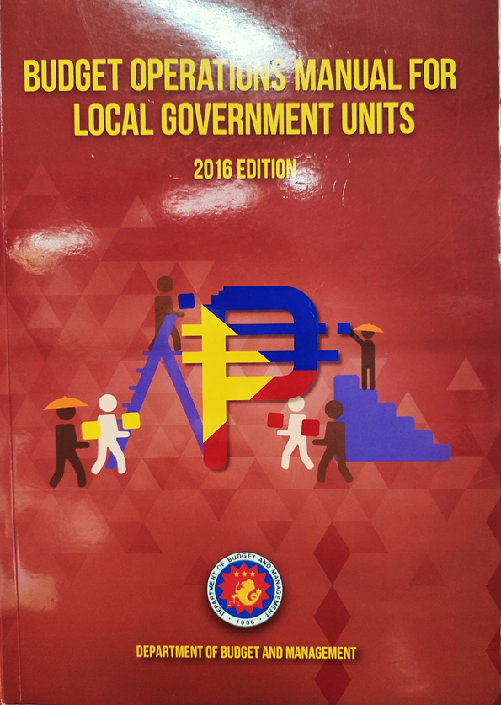
BUDGET OPERATIONS MANUAL FOR
LOCAL GOVERNMENT UNITS
Updating of the BOM for LGUs, 2016 Edition in accordance with the several significant developments in the local government sector.
The Revised BOM for LGUs is targeted to be issued in May 2023.

Slide 27
DRAFT LOCAL BUDGET MEMORANDUM RE:
FY 2024 NTA SHARES OF LGUS
Certification | Amount (Php)
 | FY 2023 | FY 2024
Bureau of Internal Revenue | 665,801,610,000 | 687,998,360,000
Bureau of Customs | 154,434,736,000 | 183,357,236,000
Bureau of the Treasury | 32,582,000 | 19,603,000
TOTAL | 820,268,928,000 | 871,375,199,000

Slide 28
DRAFT LOCAL BUDGET MEMORANDUM RE:
FY 2024 NTA SHARES OF LGUS
Inclusion of a provision for cities and municipalities to allocate a monthly cash subsidy of Php 1,000.00 for solo parents earning minimum wage and below (RA No. 11861)
Cited Local Budget Circular No. 148 dated December 23, 2022 – guidelines on the grant of honorarium to SK Officials (RA No. 11768)
Updated relevant provisions, including the President’s 8-Point Socioeconomic Agenda, and the 2022-2028 Medium-Term Fiscal Framework

Slide 29
DRAFT LOCAL BUDGET MEMORANDUM RE:
FY 2024 NTA SHARES OF LGUS
Updated Local Budget Preparation Forms and other required documents in anticipation of the issuance of the BOM for LGUs (2023 Edition)

Slide 30
1
UPDATES ON THE FULL DEVOLUTION EFFORT OF GOVERNMENT

Slide 31
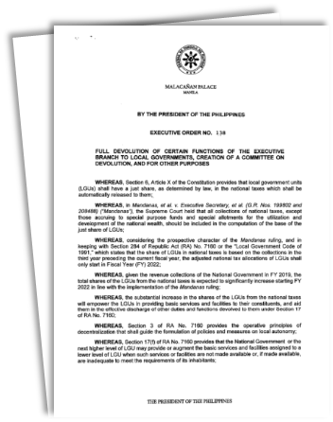
MANDANAS-GARCIA RULING AND
THE FULL DEVOLUTION EFFORT
Executive Order No. 138
dated June 1, 2021
Full devolution of certain functions of the Executive Branch to local governments in accordance with RA No. 7160
NGAs to transition towards full implementation of devolution by scaling down or phasing out certain PAPs related to devolved functions for full assumption by LGUs until FY 2024

Slide 32
STATUS OF NGA DTPs
(As of 28 April 2023)
NGA DTPs
LGU DTPs
Approved DTPs (3)
DOH | CPD/POPCOM | DOF
Awaiting Revision and Resubmission by NGAs Concerned and/or Further Evaluation by DBM (15)
DOST | DILG | DTI
DSWD | DepEd | DA
DHSUD | DPWH | DOT
DENR | DOTr | DOJ
DOLE | NIA | OPAPRU
No Submission of DTPs (2)
DOE | DICT
Summary | Total | Completed | %
Barangays | 39,451 | 39,450 | 99.99%
Cities/Municipalities | 1,477 | 1,477 | 100%
Provinces* | 114 | 113 | 99.12%
Total | 41,042 | 41,040 | 99.99%
* Including HUCs/ICCs/NCR LGUs
Source: DILG

Slide 33
REVIEW AND FURTHER STUDY OF THE CURRENT FULL DEVOLUTION TRANSITION
Assignment of responsibilities, programs, and projects between the NG and the LGUs based on the latter’s absorptive capacities
Continued provision of capacity development interventions and formulation of a long-term capacity development strategy and program for the LGUs by the NG
President’s instruction to further study the devolution efforts of the government

Slide 34

Thank you.

